Slide 1
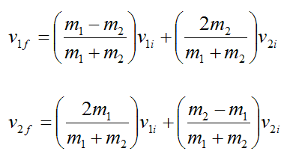
Physics 2 – Jan 14, 2020
P3 Challenge – A billiard cue ball moving at 8.35 m/s collides elastically a stationary ball with the same mass in a 1-D collision. Determine their velocities after the collision.
Today’s Objective:
Collisions Work Session / Collision PhET
Assignment:
Collisions Worksheet Complete
Get out Collisions WK for a Progress HMK check.

Slide 2
Physics 2 – Jan 14, 2020
P3 Challenge– Access the Collisions PhET…. on a laptop from Cart or use your own laptop. Java required.
Today’s Objective: Collisions Phet
Assignment:
Collisions Phet Activity - Be alert for things that don’t seem to work. (3 times). One of the three problems you can fix! Two are nonsense.
Agenda
Time to complete Collisions WS
Checked on Tuesday
Collisions Phet

Slide 3
Exit Slip - Assignment
Exit Slip- A 9000 kg train car moving at 32.5 m/s collides and couples with a 16000 kg train moving in the same direction at 12.5 m/s. What is the velocity of the new combined locomotive?
Return any borrowed laptop to the cart…PROPERLY.
What’s Due? (Pending assignments to complete.)
1D Collision PhET Simulation (Thursday – some time in class available)
What’s Next? (How to prepare for the next day)
Read 2.4 p98-108 about Momentum,

